Slide 1





Slide 2








Slide 3










Slide 4

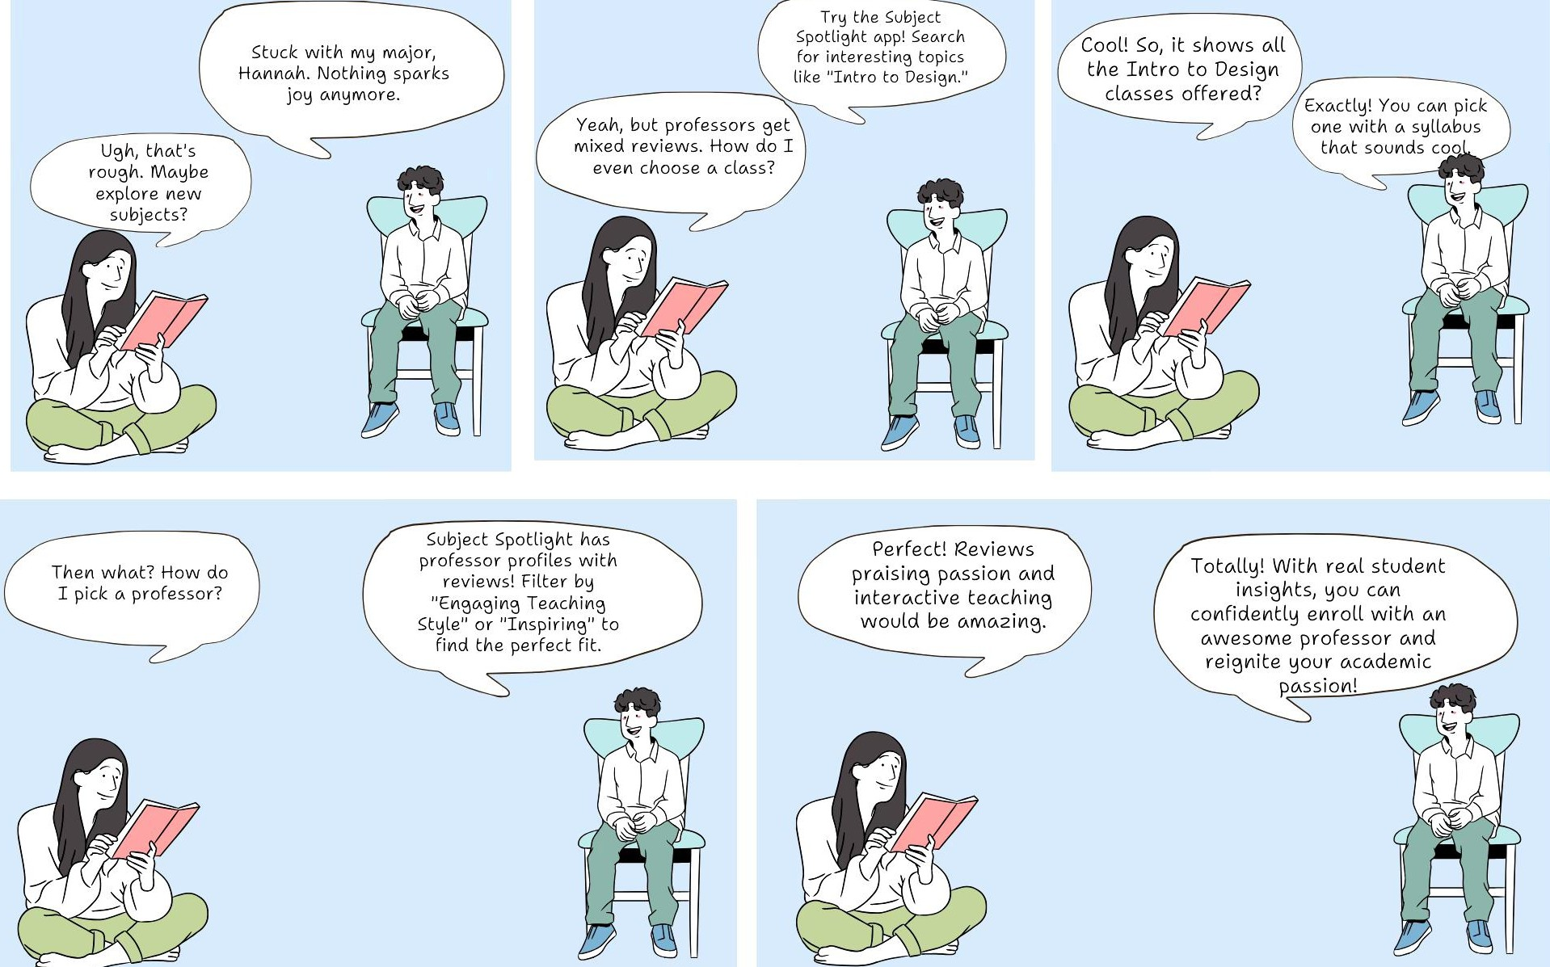


Slide 5
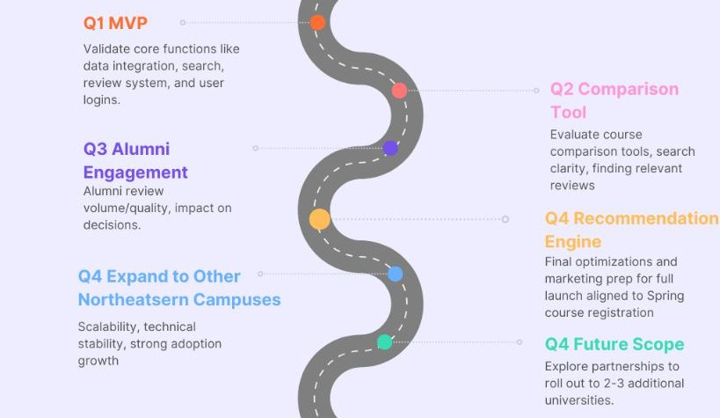

Slide 6














Slide 7
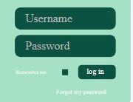











Slide 8




Active number of users per semester
Number of times reviews are marked as helpful per semester
Courses reviewed per semester

Slide 9










Slide 10

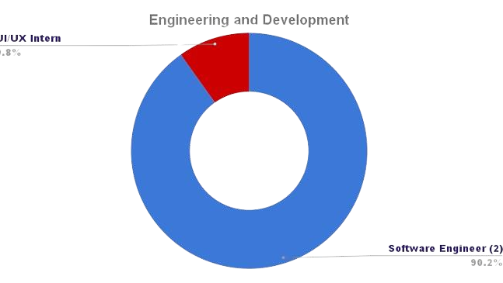
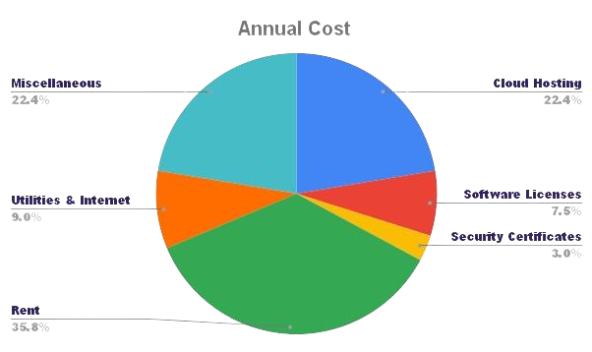


Slide 11












Slide 12



